Slide 1
DSS Discovery Training
Part II

Slide 2

Data Manipulation
More cleaning...
In this step we will perform more cleaning for our grouped data
we will use:
Formula
Find and Replace
Notes:
we will use the prepare recipe to do more cleaning
however, you might explain that we could have done all preparation before the join
but this is a good way to demonstrate that any recipe can be used at any point in the flow and as many times as the user need based on the use case

Slide 3


When are mosquitos expected to be active?
Day or Night?
Notes:
explain why we need to understand mosquitos activities as this explains why we need to calculate number of daylight hours

Slide 4


When are mosquitos expected to be active?
Day or Night?
Notes:
explain why we need to understand mosquitos activities as this explains why we need to calculate number of daylight hours

Slide 5
When are mosquitos expected to be active?
Day or Night?
How many hours?
How many hours?
Notes:
explain why we need to understand mosquitos activities as this explains why we need to calculate number of daylight hours

Slide 6
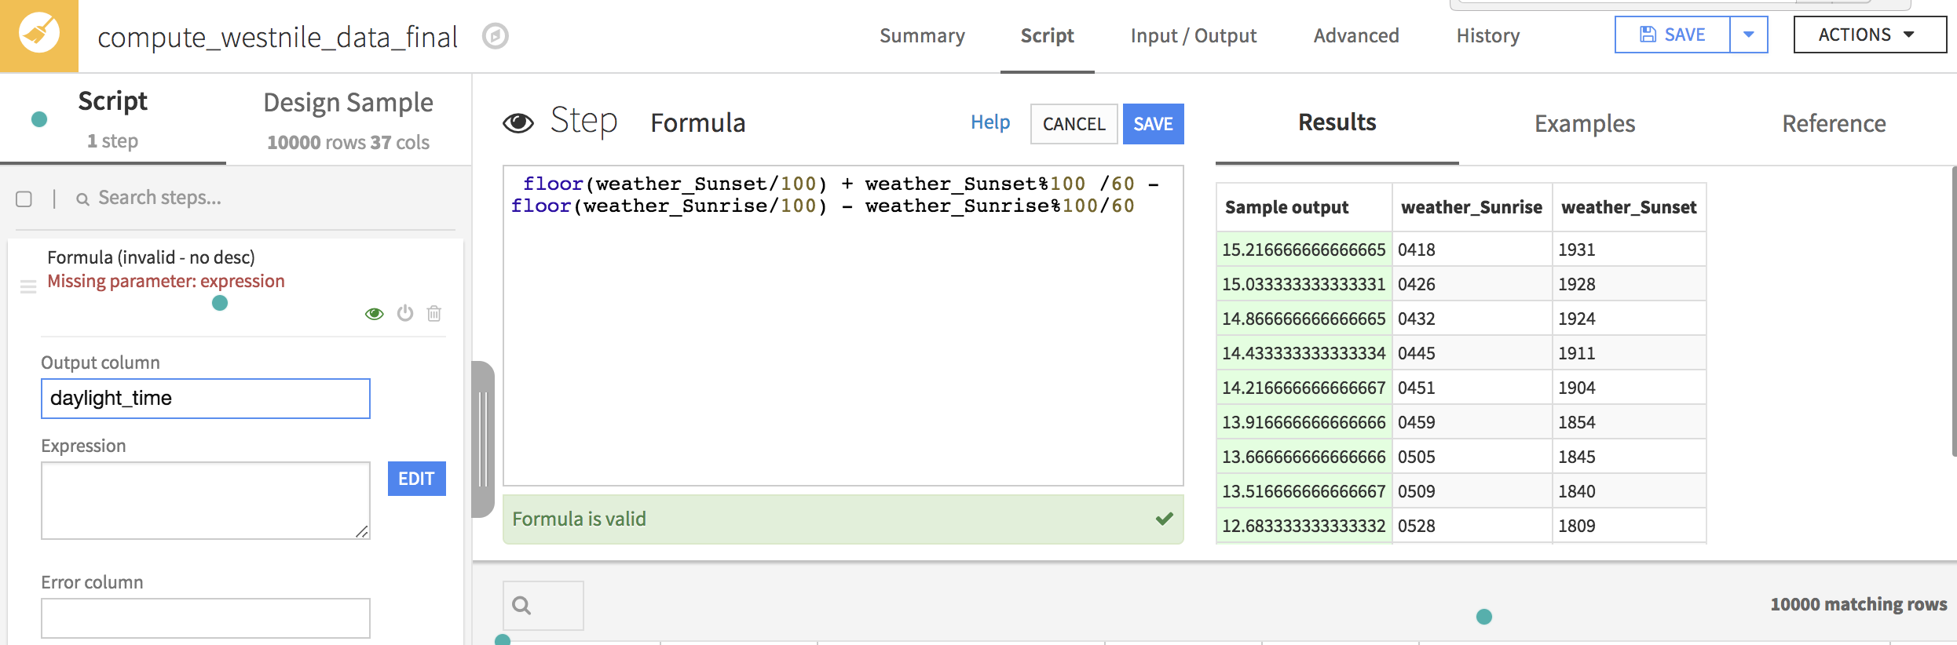
Calculate Hours of the Day….
Pick the processor “Formula” and use the below formula ….
floor(sunset/100) + sunset%100 /60 - floor(sunrise/100) - sunrise%100/60
Notes:
to calculate the number of daylight hours we will use the fields sunrise and sunset
and we will do this with the formula

Slide 7
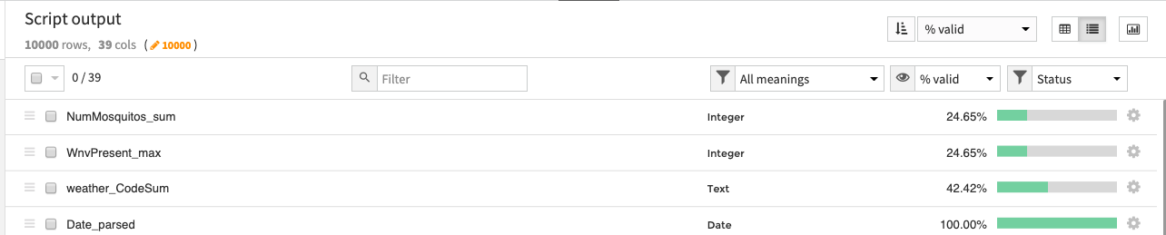
Removing columns
Which columns we’ll remove?
sorted view
% view
Mass Action
Notes:
Explain the validity and cardinality and how this will help to decide what columns to remove

Slide 8
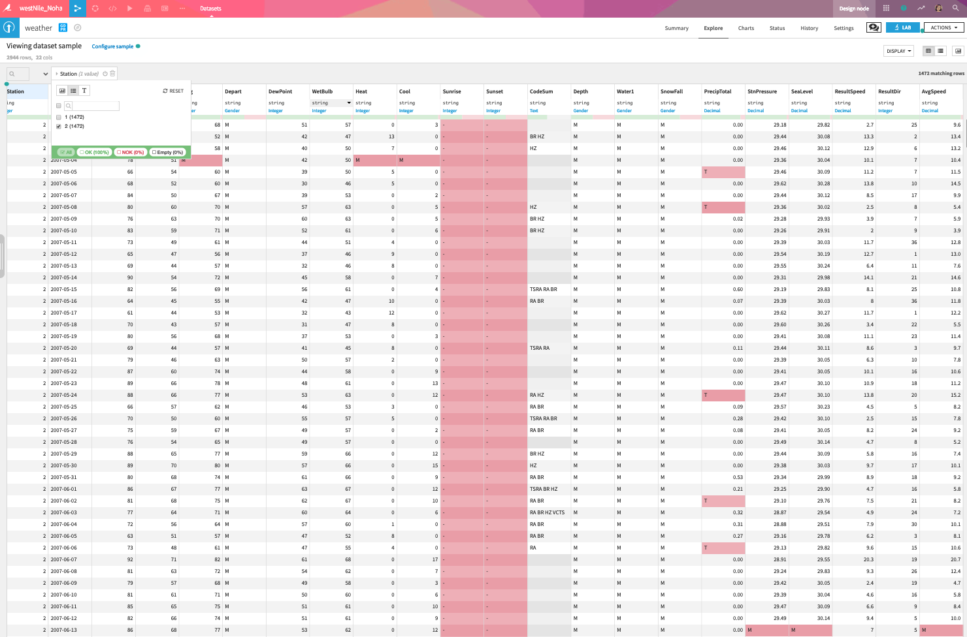
Remember the Weather dataset
with the empty row for station 2?
This is done, and we already filtered on Station 1
Now we need to replace: T and M with the correct values
Notes:
This is a reminder of some of the findings on this dataset, the Values T and M

Slide 9
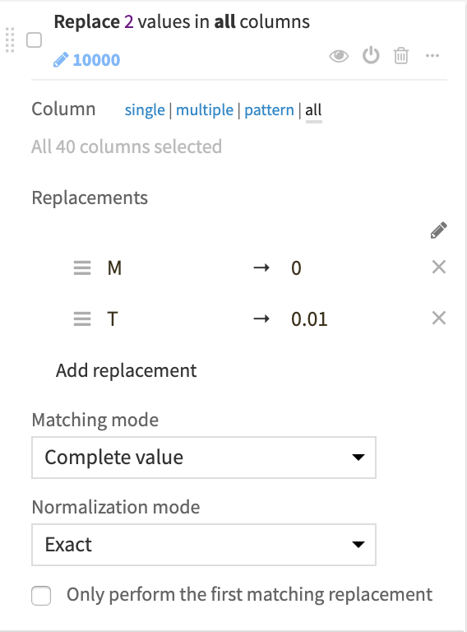
Using the processor “Find and Replace”
make sure it’s “complete Value” and “Exact”
The strings 'T' and 'M' stand for
Missing data and Trace
So, it makes sense to replace M with 0
as for Trace, Trace is defined to be 0.01
So, we will replace T with that value
Notes:
Explain how the scientist gave information about these values and what they represent, then apply the “Find and Replace” processor
Here you can speak about other options when you use "clear invalid value" and then "fill empty value with...", because they can view interesting feature (fill with average / median) and it is a good opportunity to talk about sample biais

Slide 10
Hands on!
Data Visualisation

Slide 11



Let’s build our dashboard to visualise these insights …
We will use the final dataset we have on the project flow ...
Extract the “Year” from the date
to see if there any trend in the virus spreading over the year
Extract the “Day_Number”
to help us understand how far in the year the virus tends to appear
Create a GeoPoint from “Latitude” and “Longitude” for each mosquito trap
and this will allow us to plot our data onto a map
Notes:
Reminder for purpose of the cleaning and preparing steps
now we have a dataset that we can easily use to build useful visualisation and share with stakeholders

Slide 12
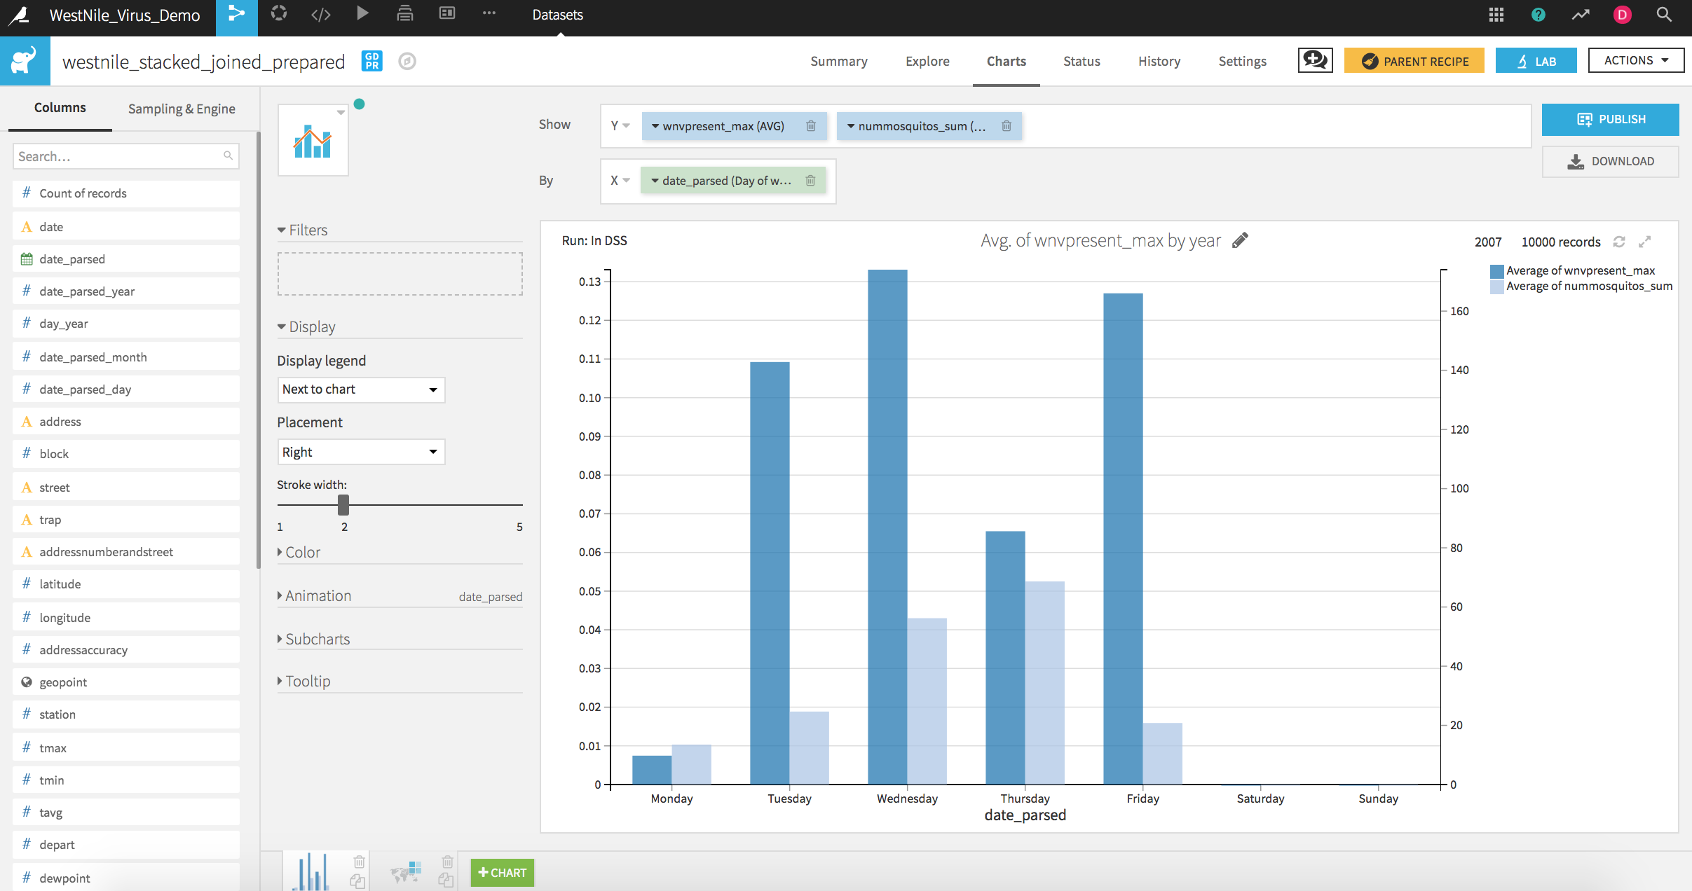
Let’s do some visualisation…
Use the final dataset in your project flow…
Multiple charts:
Select chart type as Mix.
Drag and drop the WnvPresent_max and the NumMosquitoes_sum variables onto the y-Axis field.
Click the downward pointing arrow of the NumMosquito_sum variable and select to display on the right axis.
Animate by:
Add Date_parsed to the Animation section
Select year as the grouping
Set speed to x4 for dancing fun!
Notes:
follow the steps to create the first graph

Slide 13
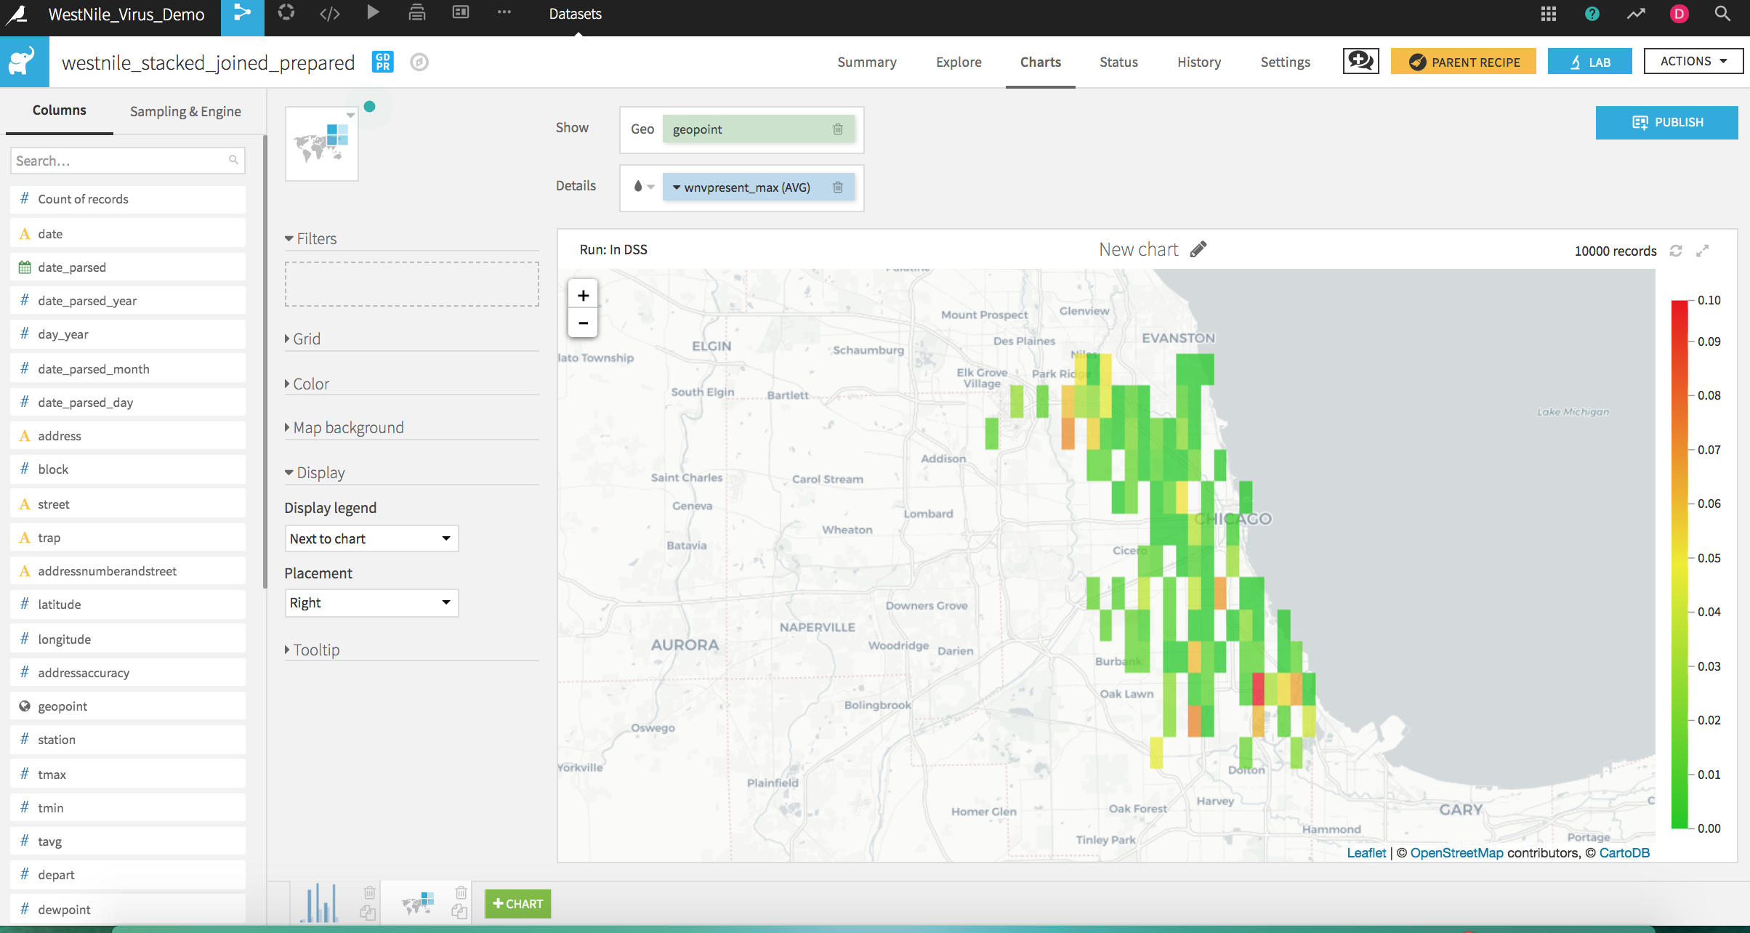
Let’s do some visualisation…
Use the final dataset in your project flow…
Notes:
second graph

Slide 14
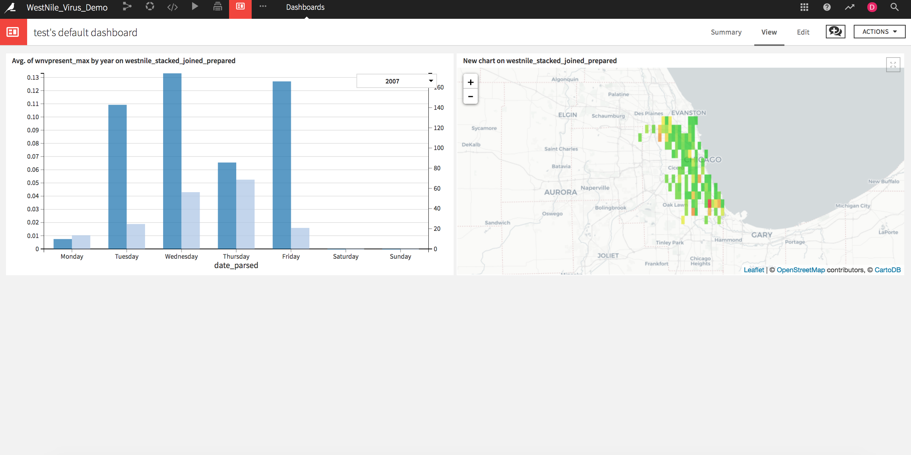
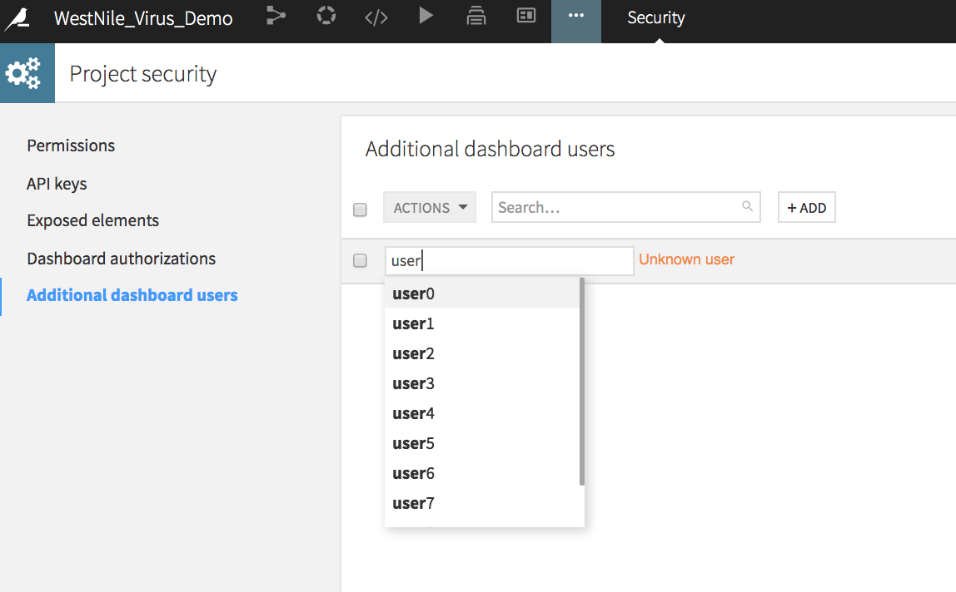
Let’s do some visualisation…
And share with our stakeholders …
Notes:
publish both on dashboard and explain how to you can provide access to it for specifis users

Slide 15
Hands on!
Machine Learning

Slide 16
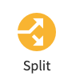
Machine Learning
Split...
In this step we will perform more cleaning for out grouped data
we will use:
Formula
Find and Replace
Notes:
Explain the Split recipe and how it will help us to split the data

Slide 17
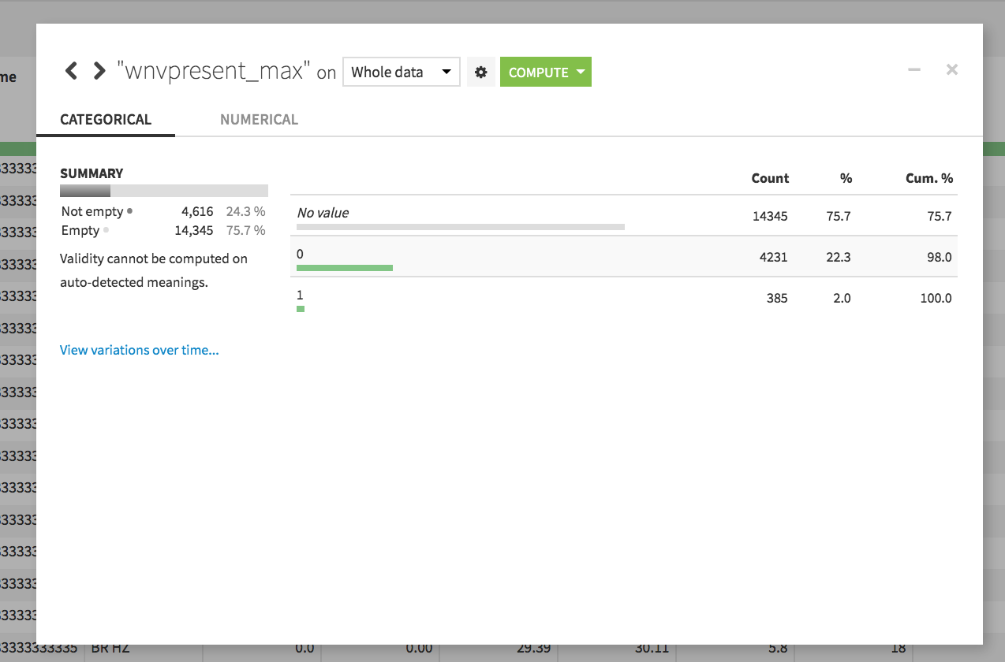
Yep, you will use “Analyze”...

Slide 18
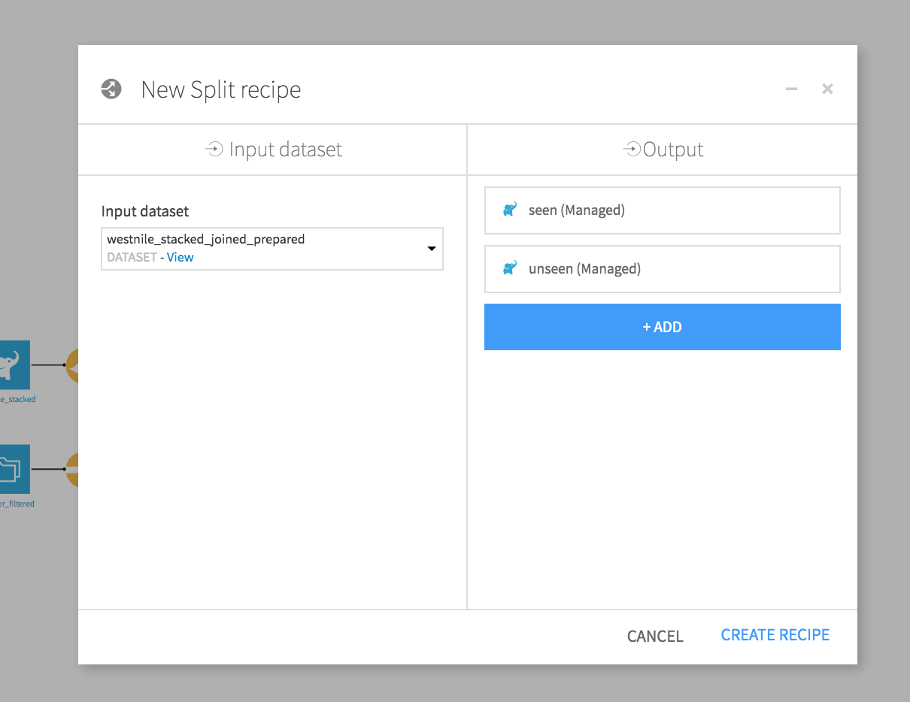
Create Two datasets (Seen and Unseen) or (Past and Prediction) or (Train and Test)

Slide 19
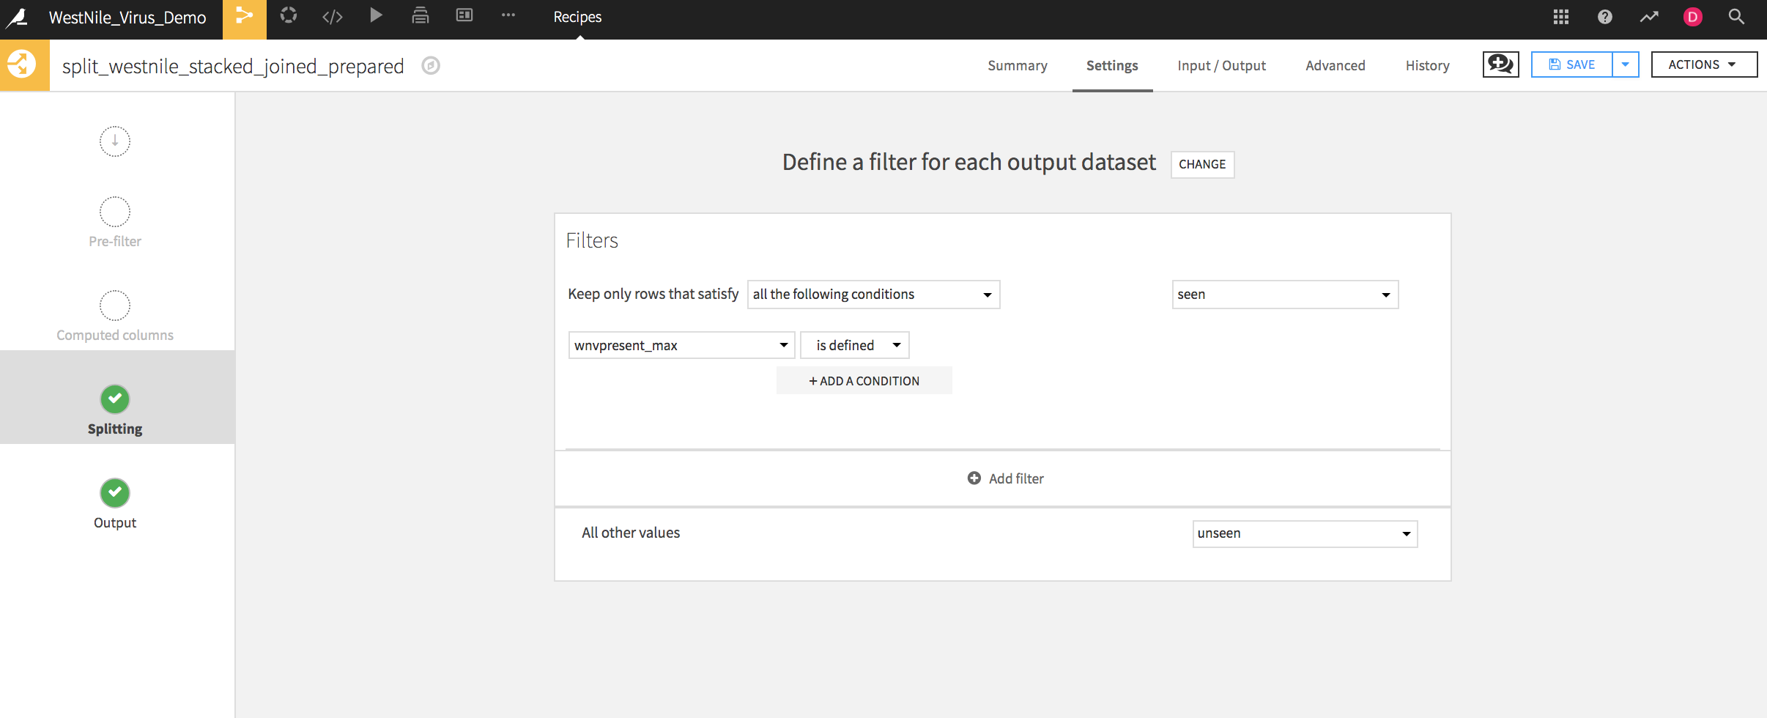
Create Two datasets (Seen and Unseen) or (Past and Prediction) or (Train and Test)
Send only rows where WnvPresent_max is defined to past
All other values to unseen
Notes:
all the 1 and 0 will be in the Seen dataset because we will use it to train our model
everything else will go to the Unseen

Slide 20
Use the “Seen” dataset and go to the lab
Let’s Train our Model
Notes:
build the ML model

Slide 21
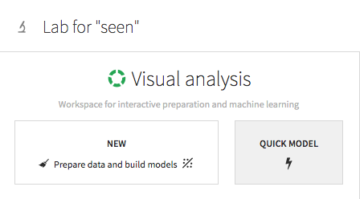
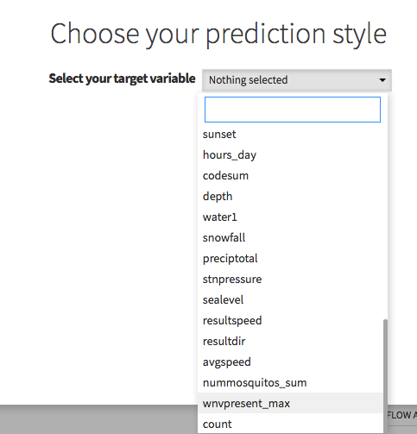
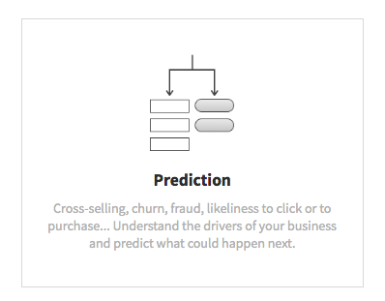
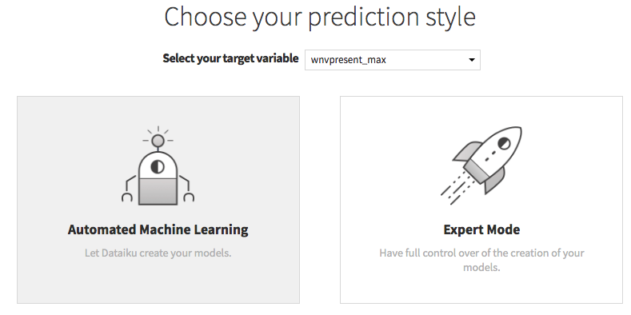
Let’s build our first predictive model

Slide 22
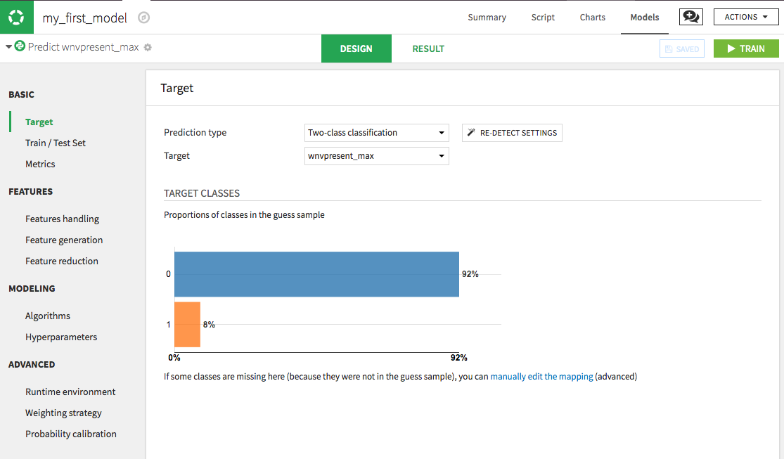
Design your model…
1
Notes:
Spend time on the Design screen to talk about some parameters
and this is a good opportunity to talk about the train/test concept
the next slides are explaining it breifly

Slide 23
Design your model…
2

Slide 24
Design your model…
3
4
5
6
Notes:
spend time on this screen to explain how you can include and exclude more features
how you can generate more features
algorithms available to use… etc.

Slide 25
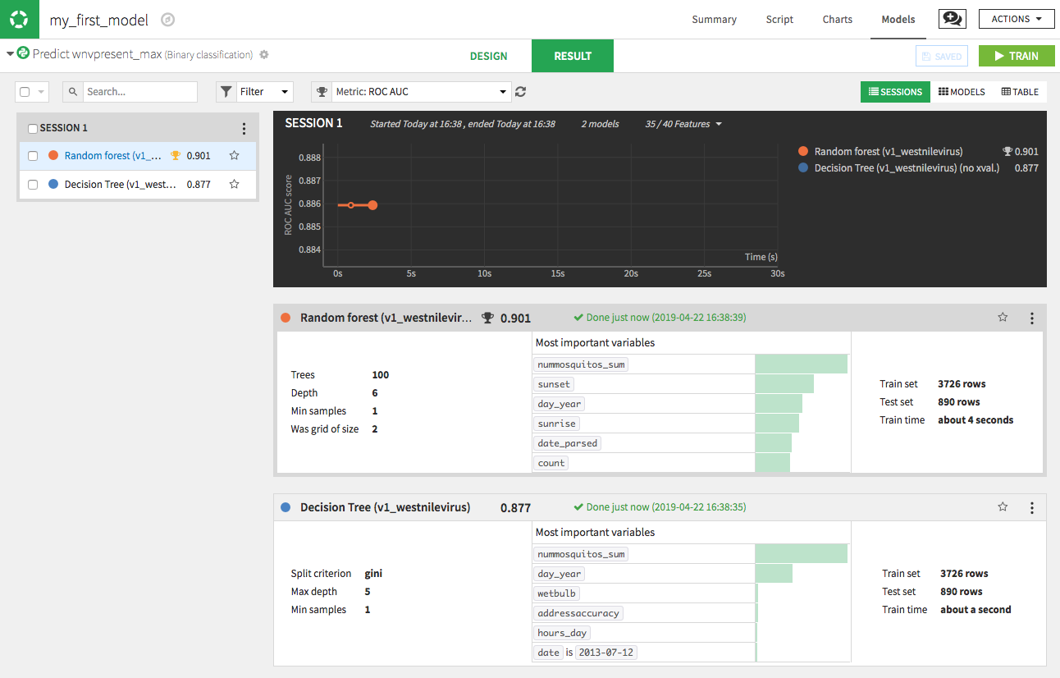
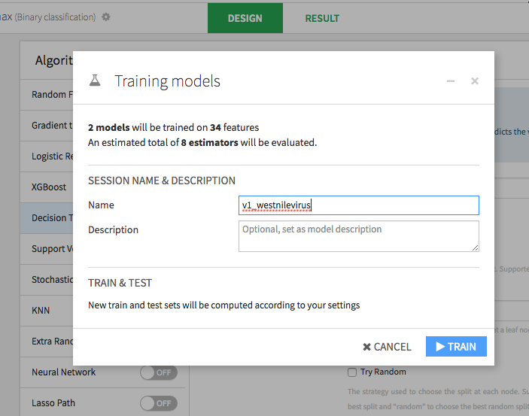
Let’s build our first predictive model
Notes:
Train the model

Slide 26
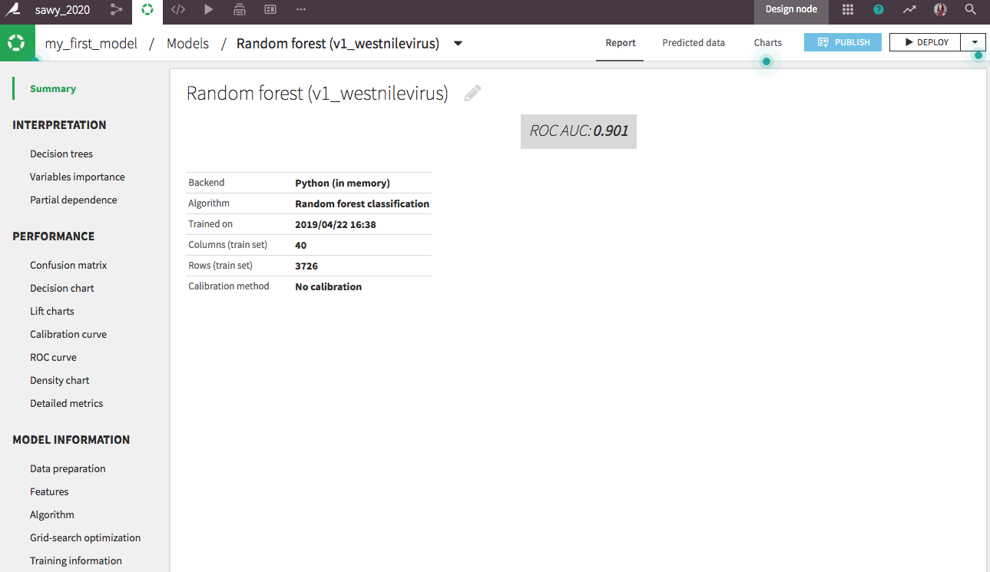
Model insights ..
1
4
2
3
Notes:
spend time and talk about the feature importance and the confusion matrix or any other relevant topic you feel is relevant

Slide 27
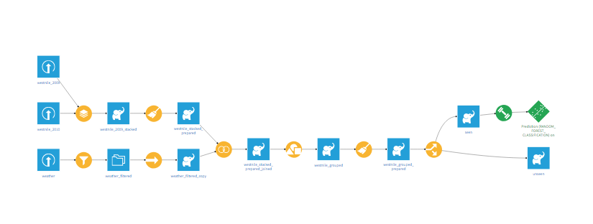

Your project flow should like this
Notes:
Make sure trainees are having the same flow before deploying the model
and change the screen shot if you need to reflect the setup you have for that training day

Slide 28
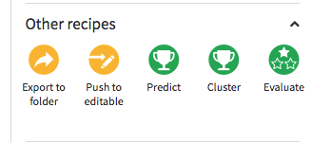
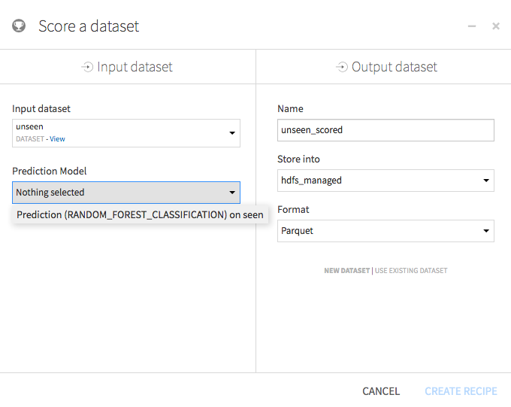
Time to apply the model to the “Unseen” dataset
Notes:
Score the Unseen dataset

Slide 29
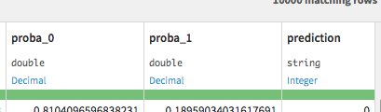
Let’s explore the final dataset …
Notes:
Explain the output dataset and how the prediction is provided based on Probabilities of the classes

Slide 30
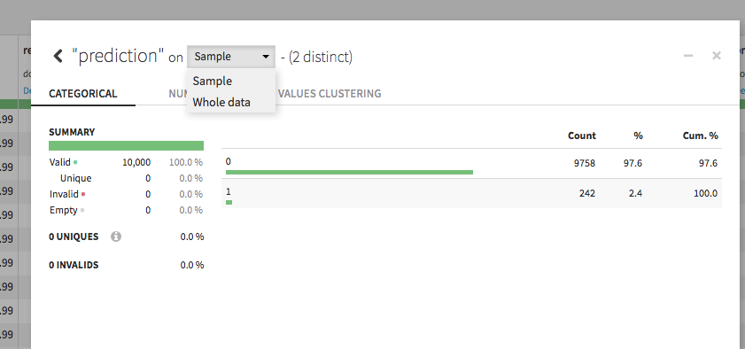
Let’s explore the final dataset …
Notes:
Explore the final dataset and again remind trainees that it will be provided for sample by default and they need to switch to “Whole data”

Slide 31
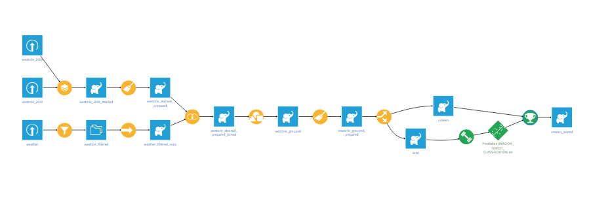
Here is your project flow… congratulations…. one more step!
Notes:
Change screenshot of you need

Slide 32
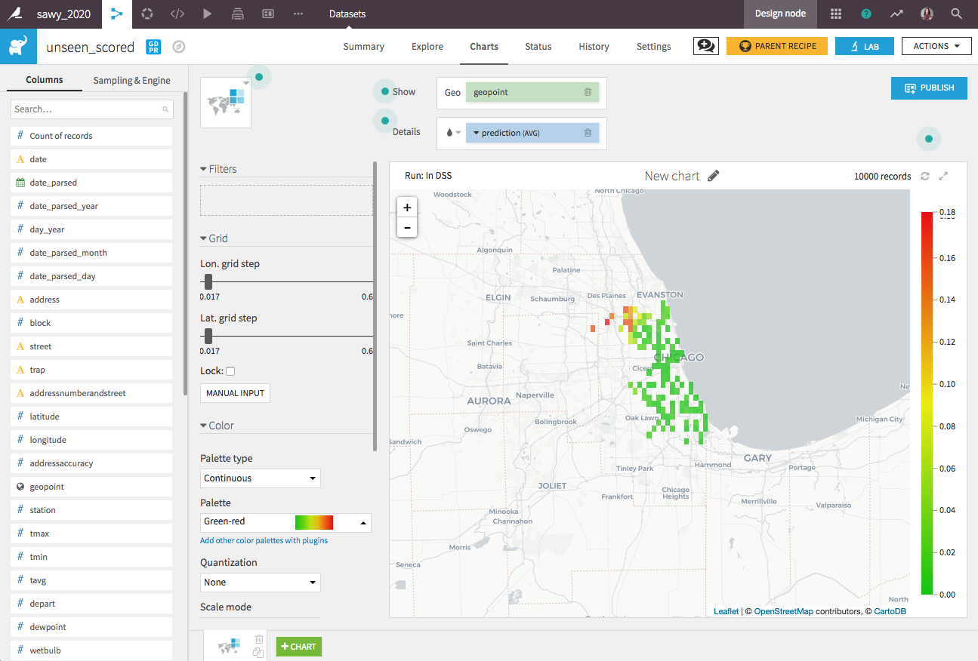
Time to go the the Mayor of Chicago and share our
predictions
Notes:
add the the final visualisation to the dashboard
this time, the graph is showing the predictions

Slide 33
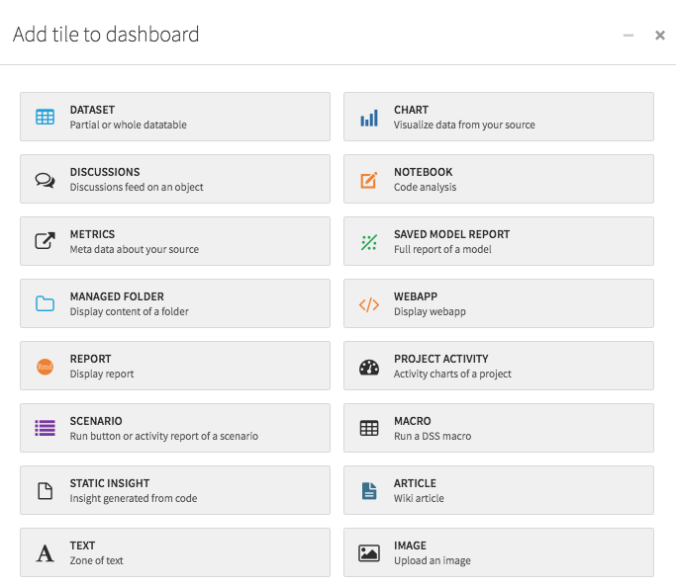
What else we can share with our stakeholders?
Notes:
Show how you can add more elements to the dashboard, feature importance or confusion matrix are a good example

Slide 34
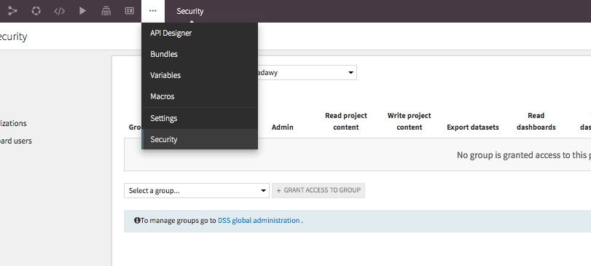
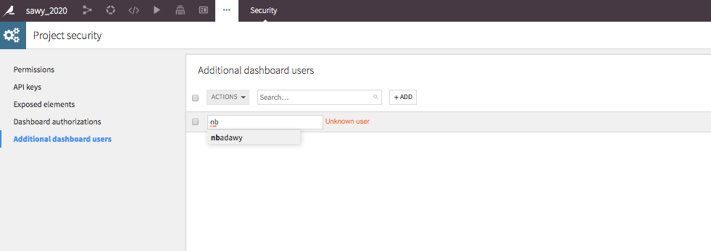
Go ahead and share the dashboard with your stakeholders

Slide 35
User Enablement resources
https://pages.dataiku.com/dataiku-dss-user-enablement
Dataiku Teachable
http://dataiku.teachable.com/courses
Dataiku Youtube Channel
https://www.youtube.com/channel/UCSMqVwPTmerMiCaL_zKRjBw
Notes:
Feel free to add more resources to this slide

Slide 36
Who likes to go to a party?!!
Pick a song!
Notes:
This is optional
but it might be a good way to finish the training day with a nice mood in the classroom

Slide 37
Who likes to go to a party?!!
Go the flow
and type the word...

Slide 38





Congratulations! enjoy the party?!!
disco

Slide 39
Thank You

